Slide 1
“The Critical Role Authors Play in Fostering a Better Society” Presented by Award-Winning Author, Janice S. Ellis, Ph.D.
“History is our greatest teacher, today presents our greatest challenges.”
--- Janice S. Ellis, Author
Books by the Author:
From Liberty to Magnolia: In Search of the American Dream (2018)
(Grand Prize Winner of the CAC2019 Journey Award for Narrative Nonfiction)
Shaping Public Opinion: How Real Advocacy Journalism Should Be Practiced (2021)
Session Description: Why do you write? A robust discussion about the need of authors to assume and carry out the responsibility to write authentically about societal conditions, and how those conditions can be understood and addressed to promote the greater good—irrespective of the genre.
Topics To Be Covered:
Why Do I Write
Nonfiction Authors
Fiction Authors
Power and Reach of the Medium
Power of the Type of Discourse
Q & A
Notes:
Happy Friday! Thank you for joining us! This session is a little different from some of the other sessions during the last few days. It is not about how to write, market or sell your book. In this session we will focus on WHY do we bother to write. Ultimately, what is the goal, or goals, for spending a chunk of our lives to put whatever thoughts are in our heads into a book for people to spend their time ready? The answer is more than “I like to write.” Or, “I am good at writing.” Even if that is true, What is the higher purpose? NEXT SLIDE

Slide 2
“The Critical Role Authors Play in Fostering a Better Society”
Goals for the Session
To have a conversation
To share experiences
To exchange ideas
Notes:
Even though we are virtual, through the chat and Q&A feature, I hope we can have a conversation, share experiences and exchange ideas. With that in mind, feel free to ask questions as we go along. PAUSE Why do we engage in the tough and hard business of writing? I don’t know about you, but it is something I have felt compelled to do. My late mother, who died at 101 years old, always would say, “You are my driven child.” PAUSE But, why do you write? I am sure that is a question that you ponder from time to time. PAUSE Why do I write? NEXT SLIDE

Slide 3
Why Do I Write? Being BLACK and WOMAN INDELIBLE and INESCAPABLE BIRTHMARKS
Notes:
To Inspire. To Empower. To Motivate. My first book, From Liberty to Magnolia: In Search of the American Dream, while the story of my life, my struggles, my triumphs, it also tells a story that millions of Americans can relate to in one way or another. Given my indelible identity, being black and being woman in America, there is so much real-life drama for me to write about. Therefore, I became a nonfiction author. I felt, and still feel, the need to write about some aspect of life in America, not just for blacks and women, but to enlighten all who care to know about and see the total tapestry of America. NEXT SLIDE

Slide 4
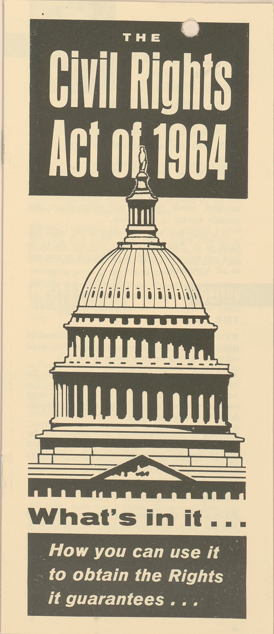
Why Do I Write? First Book: A PERSONAL ACCOUNT
The Civil Rights Act
The Equal Rights Amendment
What they have and have not meant during the last 50 years
Notes:
My life, the place of my birth, upbringing, experiences represent a microcosm of what life is like PARTICULARLY for millions of blacks, millions of women, and to a lesser extent, other minorities navigating American society during the last 50 years, and still today. I grew up, came of age, during the height of the Civil Rights movement to improve life for blacks and; as a young adult, I was in the midst of the fight for equal rights for women, which today is STILL two enduring issues. For example: the right to vote for blacks is still at risk today; and even though the Equal Rights Amendment has been passed or renewed by the U.S. Congress since 1972, it has still not been ratified by the required 38 states, and therefore the Amendment, in 2020, is not part of the Constitution of the United States. I have had a front row seat and participated in both of these seminal movements.

Slide 5
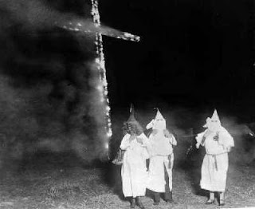
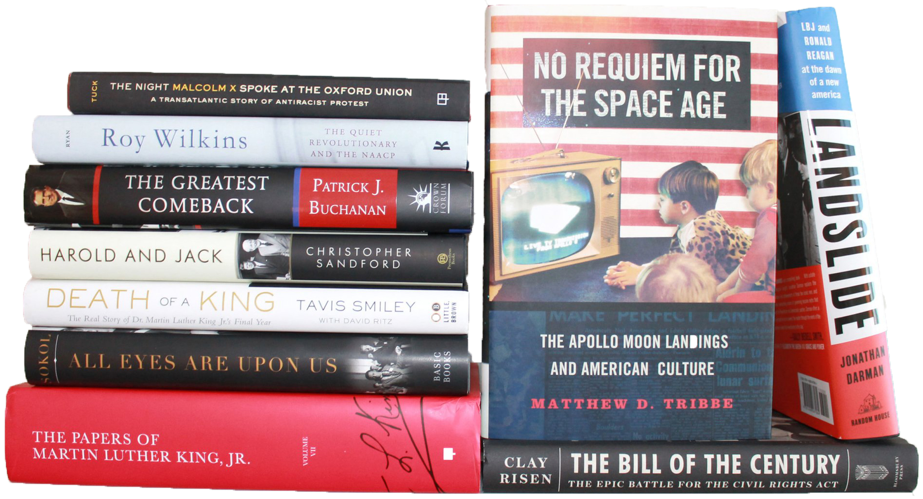
Why Do I Write? To Chronicle My Journey Between “Liberty” and “Magnolia”
Born and reared in hotbed of racism
Farm Life
Books became my friends
Notes:
But, my life and experiences are also VERY different, unique—very different from million of Americans. So, my first book, From Liberty to Magnolia: In Search of the American Dream, recounts my life—from the place of my birth, my upbringing, the nature and experiences of my family, living in the hotbed of racism in Mississippi—between two Mississippi towns, Liberty and Magnolia. With names like Liberty and Magnolia, you might imagine a place where individual freedom was treasured and everyone had an opportunity to achieve a beautiful life, their Magnolia. But life in these two towns with those iconic names was quite the contrary—at least for blacks. So, my book chronicles the richness and poverty of farm life, not only my family but for blacks generally all around me, throughout the south, and in some form all across America. My book describes the tolerated lawlessness of the Klan, the beatings, hangings, and other terror they routinely practiced in my neighborhood, and places all across the state and the south.. I was born and grew up, came of age… It was also in that environment and oppressive conditions that books became my friend, my safety net, ultimately my mental and physical escape.

Slide 6
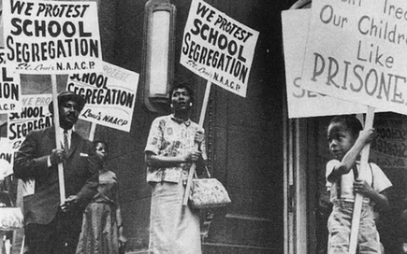
Why Do I Write? To Explain How I Discovered My Purpose
Segregated Schools
Civil Rights Movement Rising
Women’s Liberation Movement Brewing
The Encounter
Notes:
We all are shaped in one way or another by the place and conditions of our birth, our upbringing, our physical environment, the social, economic, political, cultural, other circumstances, and how they unfold in our lives. The paramount question: While all of these conditions and forces impact us, how do we choose to impact them?

Slide 7
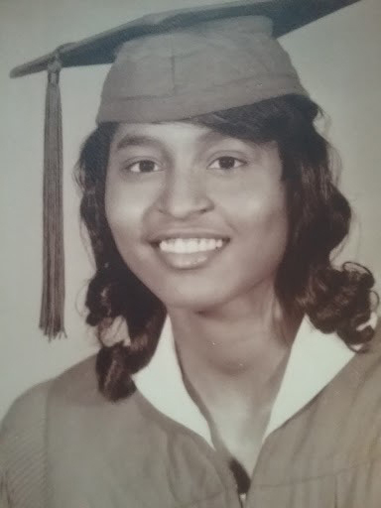
Why I Write? How I Fulfill My Purpose
Books, Grades, College
Sense of Self, Being Black
Sense of Self, Being Woman
Sense of Self, Boldness
Notes:
When I reflect upon my life, the odds of me completing high school and going to college appeared insurmountable. I was one of 7 kids, parents supported the family with the things tha Becoming an advocate journalist, which I have been most of my adult life—first as a radio commentator, then a newspaper columnist, now online. But early on, books became my friend. Determined to achieve, make my parents proud. Very competitive with me, myself and I. Determining my values, my personal and professional dreams—making good grades, chastity, marriage, parenting, becoming a teacher—long story, which I detail in my book.

Slide 8
Why Do I Write? What To Do When Dreams Meet Reality
Unavoidable Collisions
Not Glass, but Plexiglas Ceiling
Resolved, Determined, Persistent
Notes:
As I have lived the chicken-egg conundrum, being black and woman—Which comes first in the eyes of others, professionally and socially. Instead of a “Scarlet” letter, I have had two bold “sable” letters on my head that instantly put me in the black-woman dilemma—a societal, cultural, and unfairly imposed nagging deficit, a dubious distinction that seems to be a constant companion. It played out in both my educational journey and my professional career, which is also described in detail in my book. Today, it is described as being caught up in the intersectionality of race and gender. But, I grew up with the determination not to be relegated to a life of poverty, oppression, and other limitations. That determination was paramount. It was these times, these conditions, and a chance encounter with someone who came to mean a lot to me that would hep me discover my steely resolve and determine my path.

Slide 9
Why Do I Write? Purpose of My First Book
To show the gravity of the challenges that persists with systemic racism and entrenched sexism in American society, still….
To show how despite these pernicious forces one can achieve a real and meaningful purpose in life
Notes:
In writing my first book, the real purpose goes beyond myself—it is for decent, fair-minded Americans—America as a nation. It show how America has been, and continues to be, enslaved by its own sense of freedom. This sense of freedom is one that often boasts and finds it acceptable to persistently disrespect, deny, marginalize and minimize the value of two of its largest and greatest assets—women and people of color—when there is overwhelming evidence throughout the landscape that shows America has everything to gain by embracing two groups that make up the majority of its citizenry. It addresses how much there is to be gained if America boldly and courageously confront the fear that there is more to lose than gain by extending equal rights and equal opportunity to all citizens.

Slide 10
Why Do I Write? And, To Whom? TARGET AUDIENCE(S)
Americans from many walks of life
Racists and Non-Racists
Sexists and Non-Sexists
Those with the Will and Courage to make a difference
Notes:
My first book, was written as a beacon for all who are concerned about America’s future and who want America’s children of all colors to realize their full potential. It will inform the racists and non-racists, the sexists and non-sexists. It will inspire and empower men and women who are in positions that can make a difference, and who have the will to do so—parents, teachers, policymakers, social and human rights activists, journalists, business leaders, faith leaders, and many others. Caring Americans, working together, can break the chains of racism and sexism that keep America bound.

Slide 11
Why Do I Write? BOOK’S DEDICATION
Women and Girls
Those Men and Women
Stigmatized and Marginalized Groups
Family, Colleagues, Encounters
Notes:
To women and girls who believe that they can be good wives, good lovers, good mothers, and valuable contributors in achieving a better society. To those men and women who realize that skin color and gender are not negatives but positives, not deficits but assets. To the many groups of people who have been labeled minorities, but who refuse to be confined by that social ascription because they realize that everyone is a member of a minority in some way, at some time in their lives; and that being a minority is nothing to be ashamed of or feel lesser about, but instead something to be celebrated.

Slide 12
Why Do I Write? To Provide Tools: A DISCUSSION GUIDE
Book Clubs
Classes
Group and Community Forums
Notes:
The book also serves as a learning, facilitating tool for book clubs, classes, group and community forums.

Slide 13
Why Do You Write?
Other than to Captivate, to Entertain
To Inform?
To Inspire, To Motivate?
To Bring About Change?
To Challenge Belief Systems, Ideas?
To Generate Income?
Promote An Idea, An Agenda?
Other?
Notes:
When we sit down to write, we do not approach the page with a blank slate. Our place of birth, upbringing, experiences, realities, imagination, views about life, our role or purpose in it—most of all, why and how do we think our written words will have an impact, make a difference. How are our writing goals best achieved?

Slide 14
Non-Fiction Authors
As we Captivate and Entertain
Primary Focus
Past, Present, Future
Reality/Realistic
Societal (social, economic, educational, political)
Personal (autobiographical, biographical, memoir, self-help)
Other?
Notes:
Each writer has to decide what kind of author they want to be or can be best at—in the Nonfiction genre or Fiction. Each writer must gain a deep understanding of what types of writing constitutes that book of work. Non-Fiction authors primarily focus on:

Slide 15
Fiction Authors
Primary Focus
Past, Present, Future
Historical Fiction (old civilizations, folk heroes, warriors, leaders, world orders, etc.)
Horror (dark side, human degradation, terror)
Science Fiction (what can be, technological advances
Fantasy and Romance
Other?
Notes:
Fiction writers are limited only by their imagination. Some of the primary focus and types cover a wide range. Fiction books can be set in the past, present, future or any combination there of,
You have (see the categories listed in the slides)

Slide 16
Power and Reach of the Medium
Pros
Broad Reach
Print, Digital, Audio
Publishing Options
Cons
Competition, getting noticed, interest
Determining best path for your work
Notes:
The publishing world of books has undergone, and continues to undergo, radical changes. Books, whether print, digital or audio can have a broad reach. The challenge is working through all of the options and choosing the best one for your book. Do you spend time—sometime years—trying to get your book published by a large traditional publisher? Do you self publish? Are you prepared to invest time, and some money, marketing your book?

Slide 17
Power of Well-Written Books
Positives and/or Negatives of Motivation
Can inform, educate
Enlighten, inspire
Entertainment, escape
Move to action, discovery
Appeal to/Decry the baseness of human nature
Expose/Blur the lines between truth and distortion, facts and lies
Social and societal advancement/disintegration
Notes:
Whether you write fiction or non-fiction, your books can fulfill a needed and valuable purpose in many, many ways from informing, exposing, educating, inspiring, entertaining, pushing the imagination about possibilities, discovering solutions and limitless horizons—especially when their intent and motivation is to improve society overall.

Slide 18
New Books By Janice S. Ellis
Shaping Public Opinion: How Real Advocacy Journalism™ Should Be Practiced (2020/21)
The Need for Advocacy Journalism: Lessons From Walter Lippman (2021)
Using Word Power: The Making of An Advocate Journalist (2021)

Slide 19
Q & A
Questions
And
Comments
_______________
Contact Janice:
janice@janicesellis.com
Online Commentary:
https://janicesellis.com/category/life-liberty-pursuit-of-happiness/
Notes:
I have written commentary for more than 4 decades, about social, economic, political issues across race, ethnicity, gender and age. My approach has always been to look at the longer view, broad impact, lasting consequences of an issue. One editor described by writings as “Evergreens”

Slide 20
“The Critical Role Authors Play in Fostering a Better Society” Presented by Award-Winning Author, Janice S. Ellis, Ph.D.
“History is our greatest teacher, today presents our greatest challenges.”
--- Janice S. Ellis, Author
Books by the Author:
From Liberty to Magnolia: In Search of the American Dream (2018)
(Grand Prize Winner of the CAC2019 Journey Award for Narrative Nonfiction)
Shaping Public Opinion: How Real Advocacy Journalism Should Be Practiced (2020)
Session Description: Why do you write? A robust discussion about the need of authors to assume and carry out the leadership responsibility to write authentically about societal conditions, and how those conditions can be understood and addressed to promote the greater good— irrespective of the genre.
Topics To Be Covered:
Why I Write
Nonfiction Authors
Fiction Authors
Power and Reach of the Medium
Power of the Type of Discourse
Q & A

